Slide 1
Fun Fur Pets Marketing Plan
Austin Hass, Leila Holen, Kollin Burckhardt

Slide 2
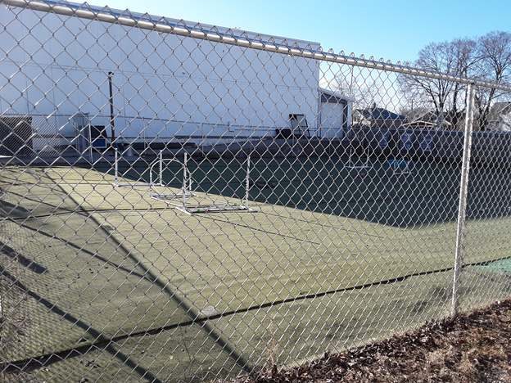
Situational Analysis: Company
The Goal:
To increase the client base by offering a fenced-in dog park, as a perk of her services. The need of utilizing the doggie daycare is still in existence but would increase her client base when the public hears of it and by word of mouth.
Proposed Dog Park Area

Slide 3
Situational Analysis: Customers
Demographics Age 18-75. Income of $25,000-$100,000. Single, Married, Married with Children. May have multiple dogs and other pets. 54601 Zip Code & surrounding areas. | Buying Behavior For their dog to attend Doggie Day Care, they must attend at least twice a month. Paying close to $100 a month. They may shop around, but they will decide to go where their pet is safe, happiest and they feel comfortable leaving them at the facility.
Psychographics The owners want the best for their dog and will research the best for their situation. Will drive a distance if a reasonable distance. | Additional Information Companion animals are children to people, and while they are price-sensitive, they will pay what they can afford, as it makes them feel comfortable leaving their pet at the facility.

Slide 4
Situational Analysis: Collaborators
Vets in the La Crosse area
Dr. Jan Schilling – Holistic Veterinary Medicine
Grooming by Jenny
Accounting services
CPR Trainers.
Vendors of products used in the business (cleaning, treats, training supplies, work attire)

Slide 5
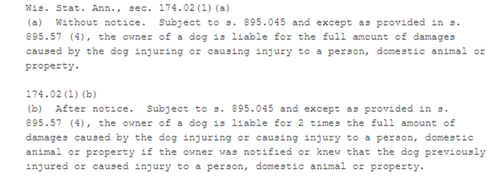
Situational Analysis: Context/Climate
Laws
Neighborhood
Pet Care

Slide 6
Situational Analysis: Competitors
Direct Competitors
Houska Dog Park
Van Riper Dog Park
Myrick Park
Viroqua Dog Park: (Unleash the Fun)
Indirect Competitors
Unplanned/ Unnamed dog parks
Private/public land
Dog Walking Apps
Wag
Rover

Slide 7
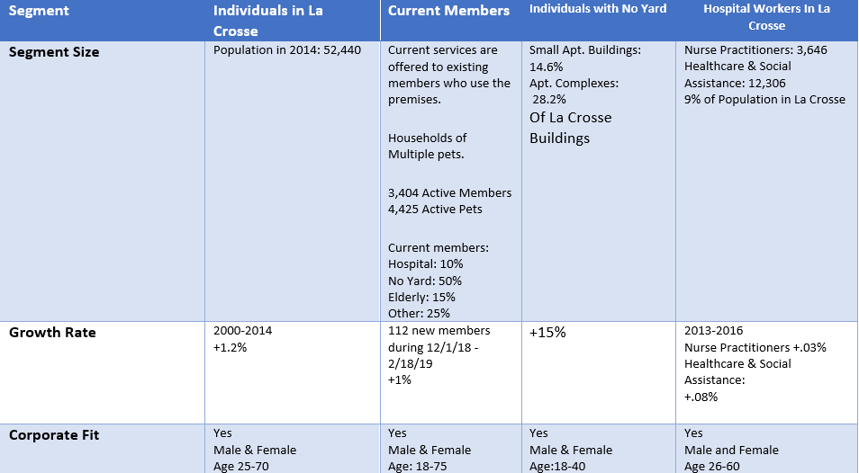
Current Fun Fur Pets Members
Hospital Workers In La Crosse
People Who Don't Have A Fenced in Yard
People Who Don’t Have A Yard/ Live In Apartment Buildings
Individuals Within 10 Mile Radius of Fun Fur Pets
College Students
Segments

Slide 8
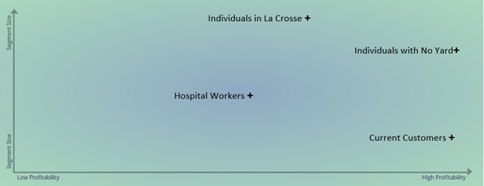
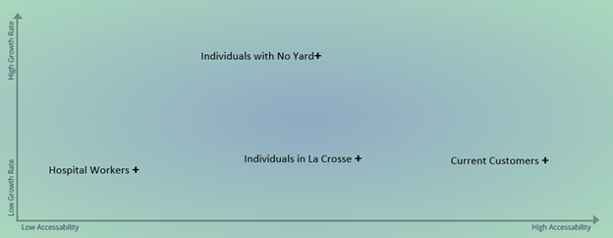
Current Fun Fur Pets Members
Hospital Workers In La Crosse
People Who Don't Have A Fenced in Yard
People Who Don’t Have A Yard/ Live In Apartment Buildings
Individuals Within 10 Mile Radius of Fun Fur Pets
College Students
Segments

Slide 9
Targeted Audience
People Who Don’t Have A Yard/ Live In Apartment Buildings
Geographic
May work or attend classes in La Crosse.
La Crosse.
Onalaska.
In-town residents.
Benefit
Open fenced in area.
Members only dog park.
Demographics
Age 25-35.
Income of $25,000-$55,000.
Single, in a relationship or just married.
Apartment renters.
Psychographics
Owner is looking to provide care and attention to their dog while they are at work.
Cost isn’t as much of an issue.
Want time to play with their dog after work hours.
Consider having dog at daycare and then using the dog park before or after they pick up from dog daycare.

Slide 10
Targeted Audience Continued..
People Who Don’t Have A Yard/ Live In Apartment Buildings
Usage Rate
Need to have certain amount of day care each month.
Find time to come.
Barriers
Need to have certain amount of day care each month.
Find time to come.
Sign up for key fob.
Motivators
Having a fenced in place to play with their dogs is attractive to them.
Able to schedule before or after work use of the dog park, what works for their schedule.
Located close to Downtown La Crosse.

Slide 11
Positioning Statement
“Fun Fur Pets offers doggie day care, boarding and training in our facility. We recognize the need in for our community for a secure dog park where residents may stop in and spend time with their companion animals. Our Dog Park offers your fur babies the space to run around and play in safety. Our fenced in yard allows you the peace of mind that no matter when you come and visit, our grounds are a secure, well-lighted clean facility.”

Slide 12
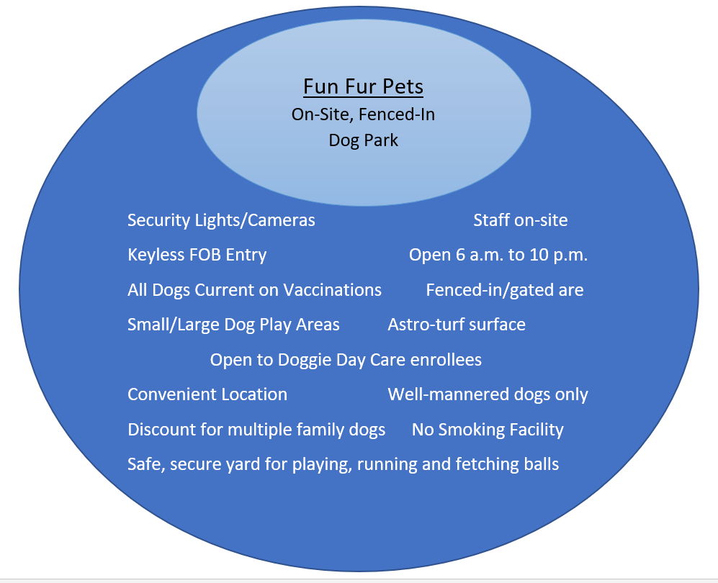
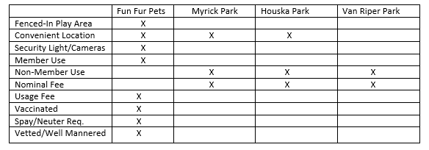
Product

Slide 13
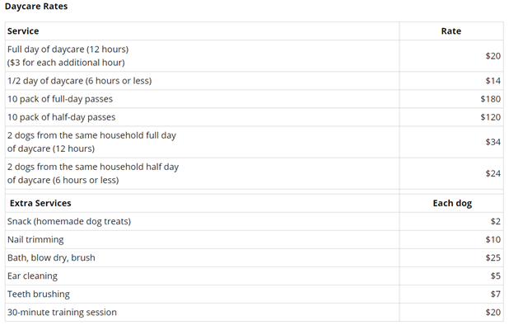
Pricing/ Place
$25 per month ($300/yr.)
$260 per year (Discount)
Promotional offerings (Holidays/Time of the Year)
Hours:
Monday through Friday: 5:30 AM–10:30 PM
Saturday: 6:30 AM–6:30 PM, 9–10:30 PM
Sunday: 6:30–8 AM, 12–1:30 PM, 5–6:30 PM, 9–10:30 PM

Slide 14
Distribution Channel
Distribution - process of making the product available to the customers who need it.
Direct:
Current Customers
Indirect:
La Crosse Tribune Sunday Business Section
Wags to Whiskers
Humane Society
PetSmart/Petco (Community Boards & Adoption Events)
Area Rescues & Fosters
Veterinarians - they are the advocates for up-to-date vaccinations
Any one who comes in contact with anyone who uses Fun Fur Pets

Slide 15
Promotions
Name Choices:
Fun Fur Dogs' Park
Doggie Den
Fun Fur Pets Playground
Bark Park
Pooch Playground
Goal
Background

Slide 16
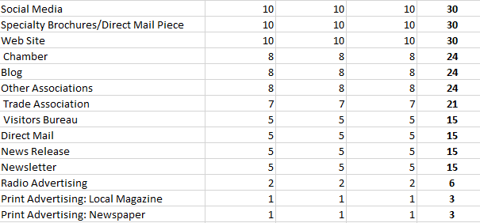
Our Selection
Our process involved assigning a value to the platforms available in the area, and ones we felt were most appropriate to our target.

Slide 17
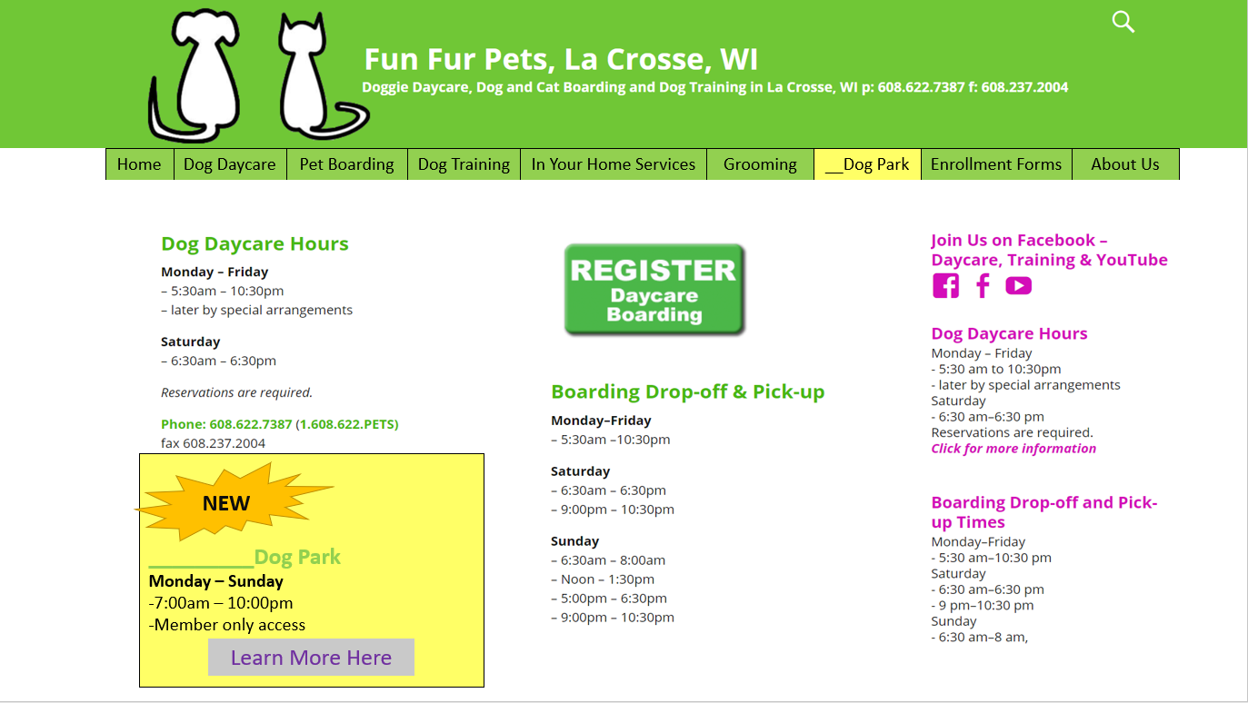
Implementation
Website:

Slide 18
Possible Promotions
Promotional Print Items
Tri-fold brochures- Office Depot $1.07 each
Flyers-Office Depot $.42 each
Yard Signs - Office Depot $15 each
Vinyl Mesh 8X4 Banners Office Depot $96 each
Reactive Dog Use of park
Schedule time for only dogs that may be reactive
Install Privacy Slats (every other fence panel)
$69.99pkg 6 foot tall fence, 10 linear feet coverage
Flyer
Trifolds/ Brochures
Banner

Slide 19
Possible Promotions
Direct Mail
Postcards - Office Depot 200 -$26.99 (this does not include a mailing list at this time)
Client Emails
Clients would receive “Fun Fur Pets News” email regarding the launch of the dog park and inform their friends.

Slide 20
Social Media
Facebook
Groups
Messenger
Ads
Instagram
Photo Content
YouTube
Advertise Services
Promotional Video of dog park
Upload to other media
Snapchat
Geo-Filter location
Awareness

Slide 21
Possible Promotions
Community Opportunities - another way of promoting the dog park is by participating in events and visiting dog-related businesses that could help spread the word.
Petsmart Community Adoption Event - May 17-19,2019
Coulee Region Humane Society-
A brochure could be placed with the “The Canine You Adopted” bag when you adopt.
Offer a discount.
Other professional relationships
Fosters and Rescues
Community Boards
Wags to Whiskers, for example
La Crosse Tribune Business Section (Announcements)

Slide 22
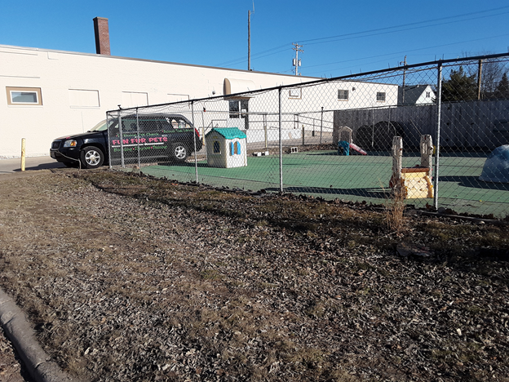
Yard Signs and Banner Placement
Banner placed on the Daycare Fence

Slide 23
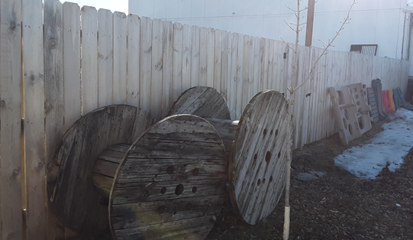
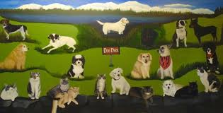
Blank “Canvas”
This is the wooden fence between Green Bay Street and the Dog Park.
The fence could be painted a permanent “Dog Park” Mural.
Mural: Artist Dina Mae Pratt
Our Companions Animal Sanctuary
Ashford, CT

Slide 24
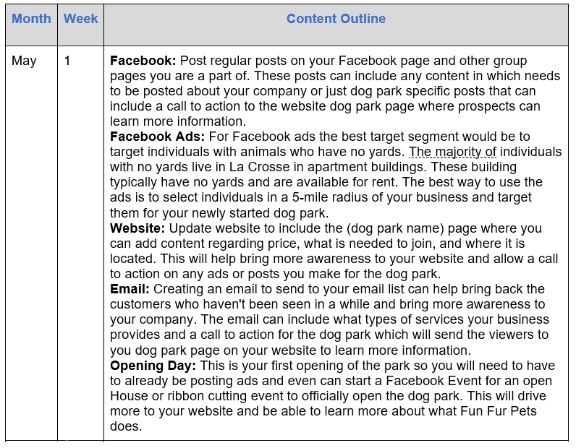
Content Calendar

Slide 25
Budget
Facebook post boost
Costs 1 dollar a day minimum, but can be boosted more with more money spent
Facebook Ads
All done by cost per click so daily budget must be set to limit how much you will have to pay
Email
Current customers so the cost is only time taken to create and send email

Slide 26
Conclusion
People Who Don’t Have A Yard/ Live In Apartment Buildings
Fun Fur Pets offers doggie day care, boarding and training in our facility. We recognize the need in for our community for a secure dog park where residents may stop in and spend time with their companion animals. Our Dog Park offers your fur babies the space to run around and play in safety. Our fenced in yard allows you the peace of mind that no matter when you come and visit, our grounds are a secure, well-lighted clean facility.
Content Calendar
Facebook posts/Ads
Email
Website
Holidays
Fun Fur Dogs' Park Doggie Den
Bark Park Pooch Playground Fun Fur Pets Playground

